Slide 1
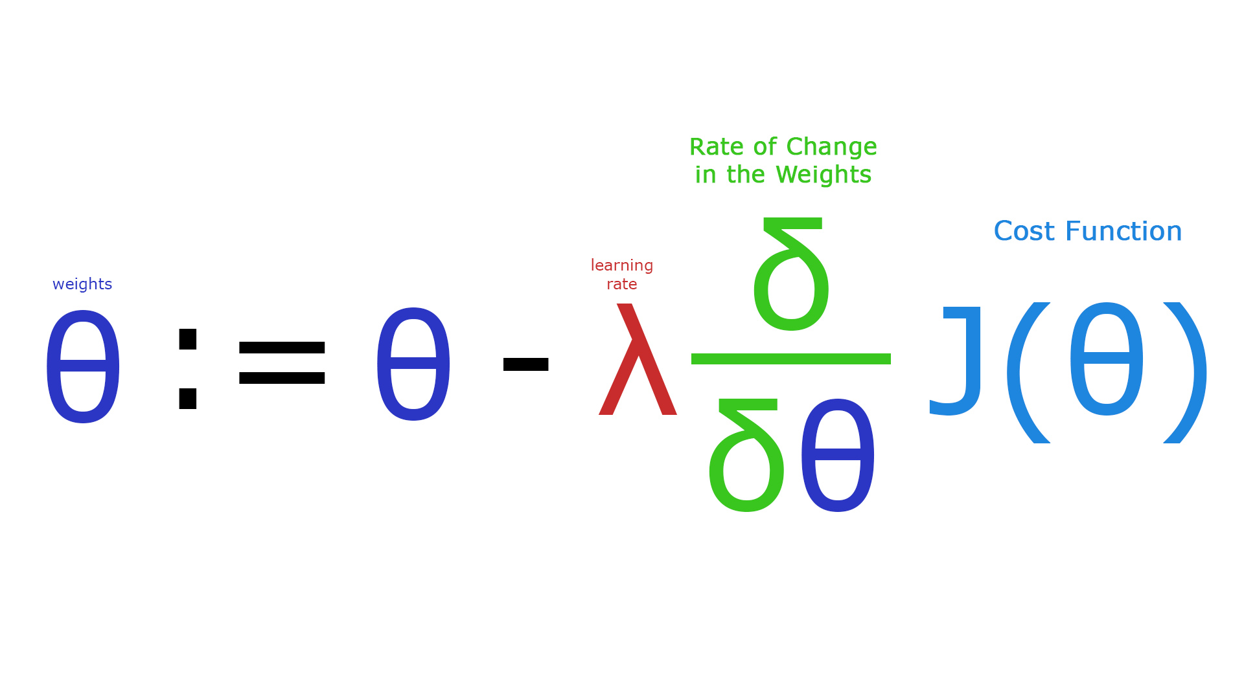
Machine Intelligence and Networking Challenges, Opportunities and Realities
David Meyer
Brocade Chief Scientist, VP and Fellow
Senior Research Scientist, Computer Science, University of Oregon
dmm@{brocade.com,uoregon.edu,1-4-5.net,..}
http://www.1-4-5.net/~dmm/ml/talks/2016/cor_ml4networking.{pptx,pdf}
Network Machine Learning Research Group
IETF 97
13 – 18 Nov 2016
Seoul, Republic of Korea

Slide 2
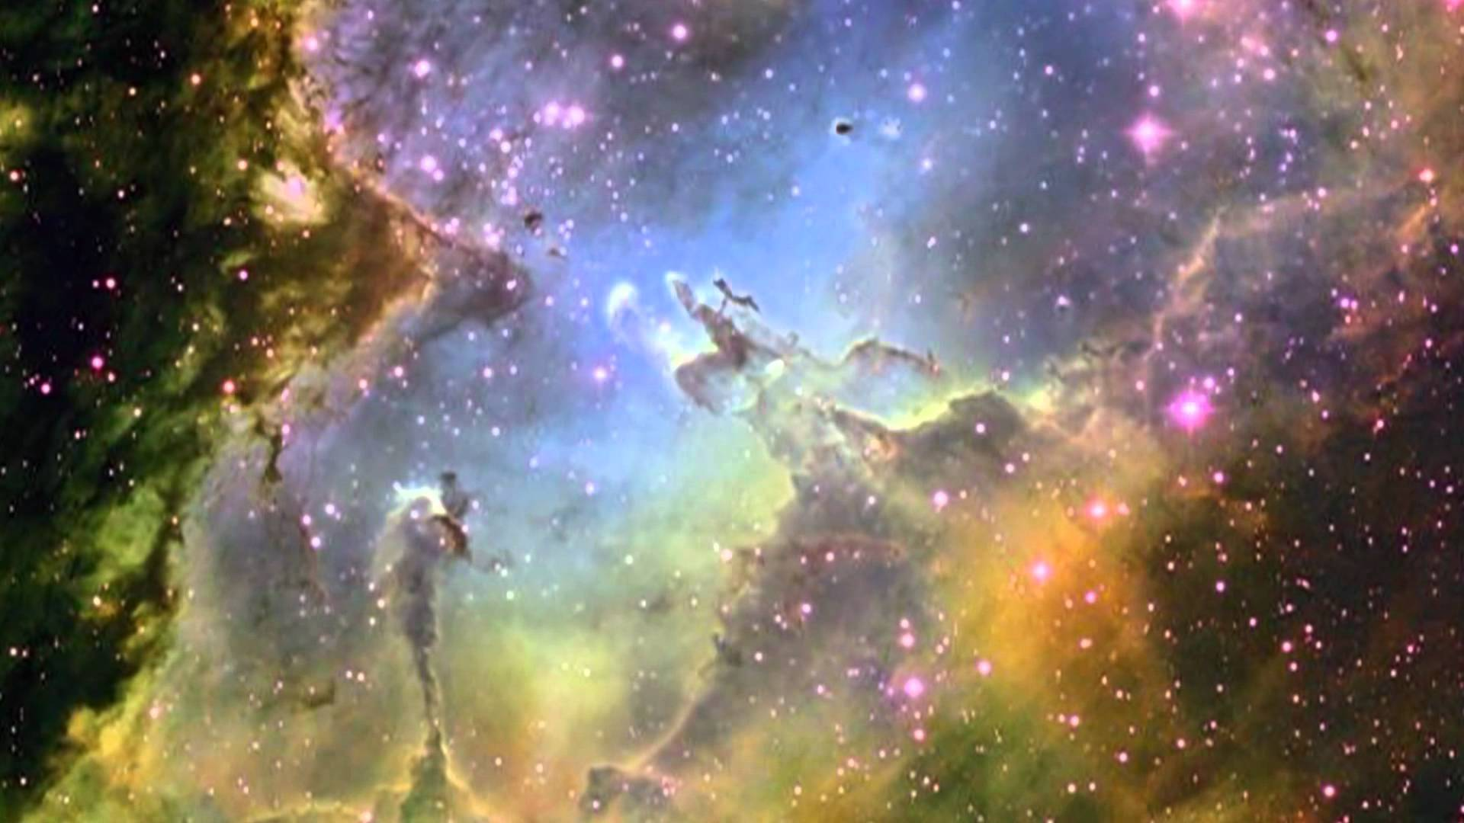
Goals For This Talk
The goals for this talk are to briefly review the
state of the art in Machine Learning as applied to data networking, with particular focus on
What is practical today
What are the challenges¹, and
What are the opportunities
We’ll go easy on the math here, but if you’re interested in that part of all of this
see http://www.1-4-5.net/~dmm/ml for some introductory material.
1 Noting the these challenges are both technological and socio-economic.

Slide 3
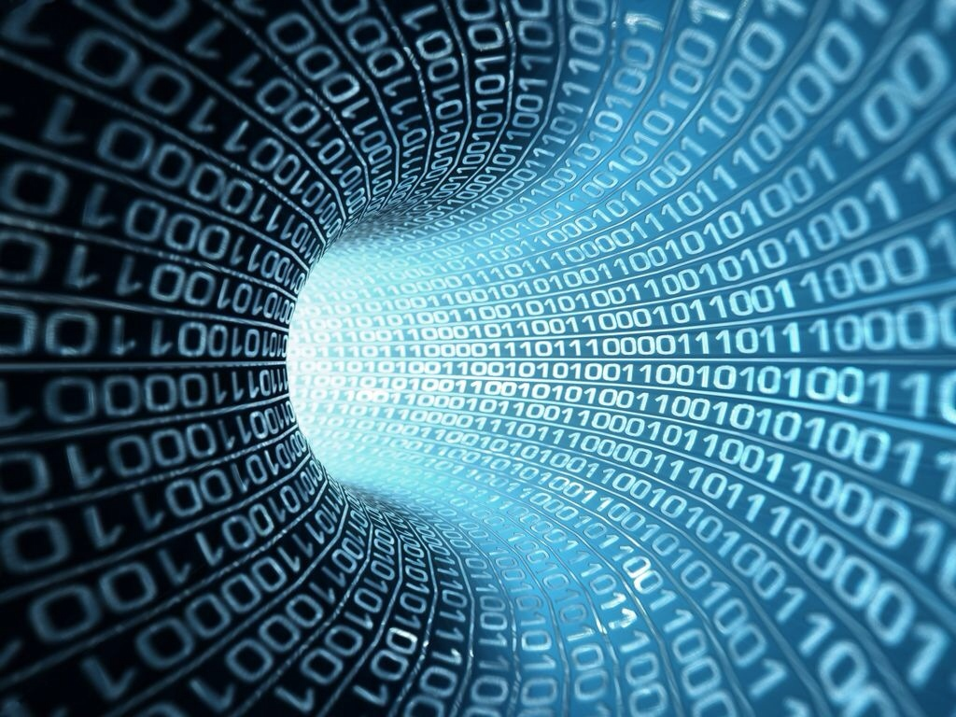
You might be surprised but what is going to drive innovation in the enterprise and in the public cloud is machine learning.
Bill Coughran, Sequoia Capital #‎ONUGSpring16‬

Slide 4
Machine Learning is the way we are going to automate your automation.
Chris Wright, RedHat CTO #RHSummit

Slide 5
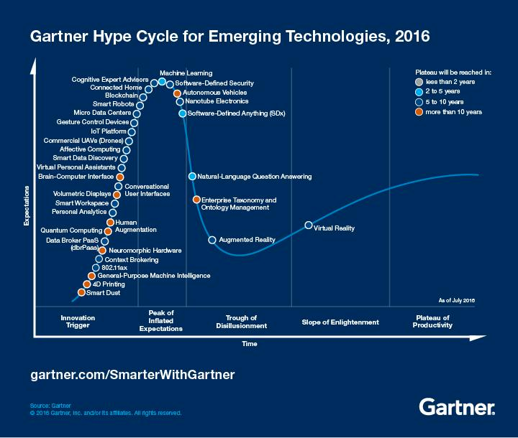
But Be Careful…
You are here (again)
https://en.wikipedia.org/wiki/AI_winter

Slide 6
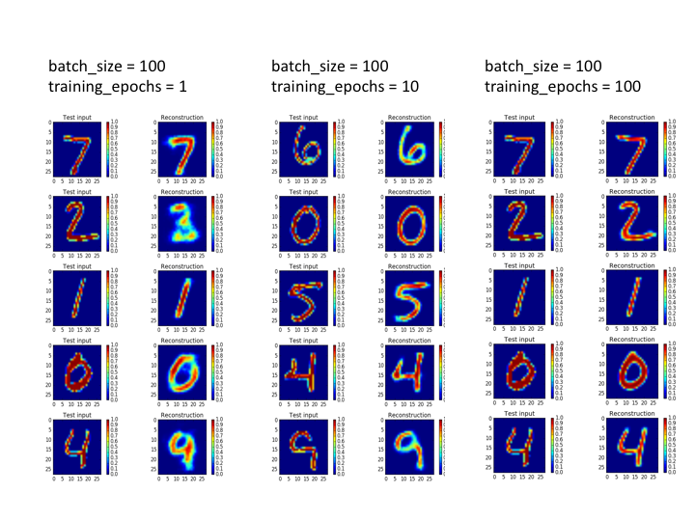
Agenda
What Is Machine Learning?
What Can We Do Today, And What Are The Challenges?
What’s On the Horizon?
Technical explanations/code
https://github.com/davidmeyer/ml
http://www.1-4-5.net/~dmm/ml

Slide 7
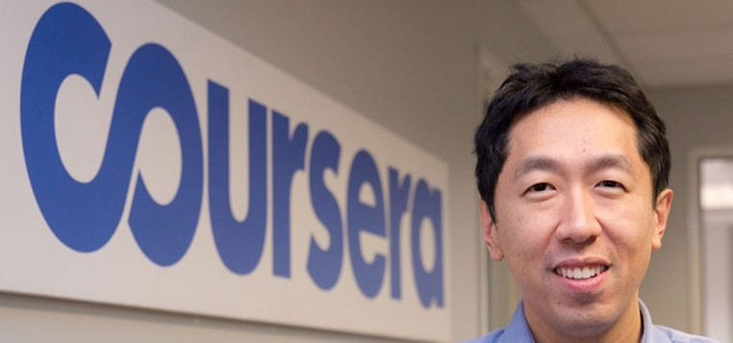
What Is Machine Learning?
The complexity in traditional computer programming is in the code (programs that people write). In machine learning, learning algorithms are in principle simple and the complexity (structure) is in the data. Is there a way that we can automatically learn that structure? That is what is at the heart of machine learning.
-- Andrew Ng
Said another way, we want to discover the Data Generating Distribution and the associated process (or processes) that underlies the data that we observe. This is the function that we want to learn.
Moreover, we care about primarily about the generalization accuracy of our model (function)
Accuracy on examples we have not yet seen (BTW, how is this possible?)
as opposed the accuracy on the training set (note: overfitting)

Slide 8
Same Thing Said In Cartoon Form
(Three main types of Machine Learning)
Traditional Programming
Data
Computer
Output
Program
Machine Learning
Data
Computer
Program
Environment
Output
Supervised Learning: training set of the form {(x_{i},y_{i})}; y_{i} = f(x_{i})
Reinforcement Learning: Learn from interaction with environment
Unsupervised Learning: training set of the form {x_{i}}

Slide 9
So When Would We Use Machine Learning?
When patterns exists in our data
Even if we don’t know what they are
Or perhaps especially when we don’t know what they are
Or if they are just noise
We can not pin down the functional relationships mathematically
Else we would just code up the algorithm
Neural networks as function approximators
Need this for scale
When we have lots of (unlabeled) data
Labeled training sets harder to come by
Data is of high-dimension
High dimension “features”
For example, sensor data
Want to “discover” lower-dimension representations
Dimension reduction
Aside: Machine Learning is heavily focused on implementability
Frequently using well know numerical optimization techniques
Lots of open source code available
All kinds of open source frame works, e.g., https://www.tensorflow.org/ or http://torch.ch/ or …
Well-worn libraries http://scikit-learn.org/stable/ (many others)

Slide 10
Examples of Machine Learning Problems
Pattern Recognition
Facial identities or facial expressions
Handwritten or spoken words (e.g., Siri)
Medical images
Sensor Data/IoT
Recommender Systems
Optimization
Many parameters have “hidden” relationships that can be the basis of optimization
Pattern Generation
Generating images or motion sequences
Anomaly Detection
Unusual patterns in the telemetry from physical and/or virtual plants (e.g., data centers)
Unusual sequences of credit card transactions
Unusual patterns of sensor data from a nuclear power plant
or unusual sound in your car engine or …
Prediction
Future stock prices or currency exchange rates
Network events
…

Slide 11
Agenda
What Is Machine Learning?
What Can We Do Today, And What Are The Challenges?
What’s On the Horizon?
Technical explanations/code
https://github.com/davidmeyer/ml
http://www.1-4-5.net/~dmm/ml

Slide 12
First, What Does The Scientific Method Look Like When Applied To Machine Learning?
Automation meets ML
This needs to be fast!
Use Case / problem definition
Scripting
HPC, GPUs, …
Hypothesis
Design ML Experiment
Execute ML Experiment
Use cases collected through Research/Customer(s)
e.g. Autoencoders can detect anomalies in various data sources
Prototype environment, variable def., experimental control, significance, etc.
Execute, measure, and update hypothesis if necessary
“If you want to increase your success rate, double your failure rate” Thomas Watson Sr. (founder of IBM)
Original slide courtesy Armin Wasicek

Slide 13
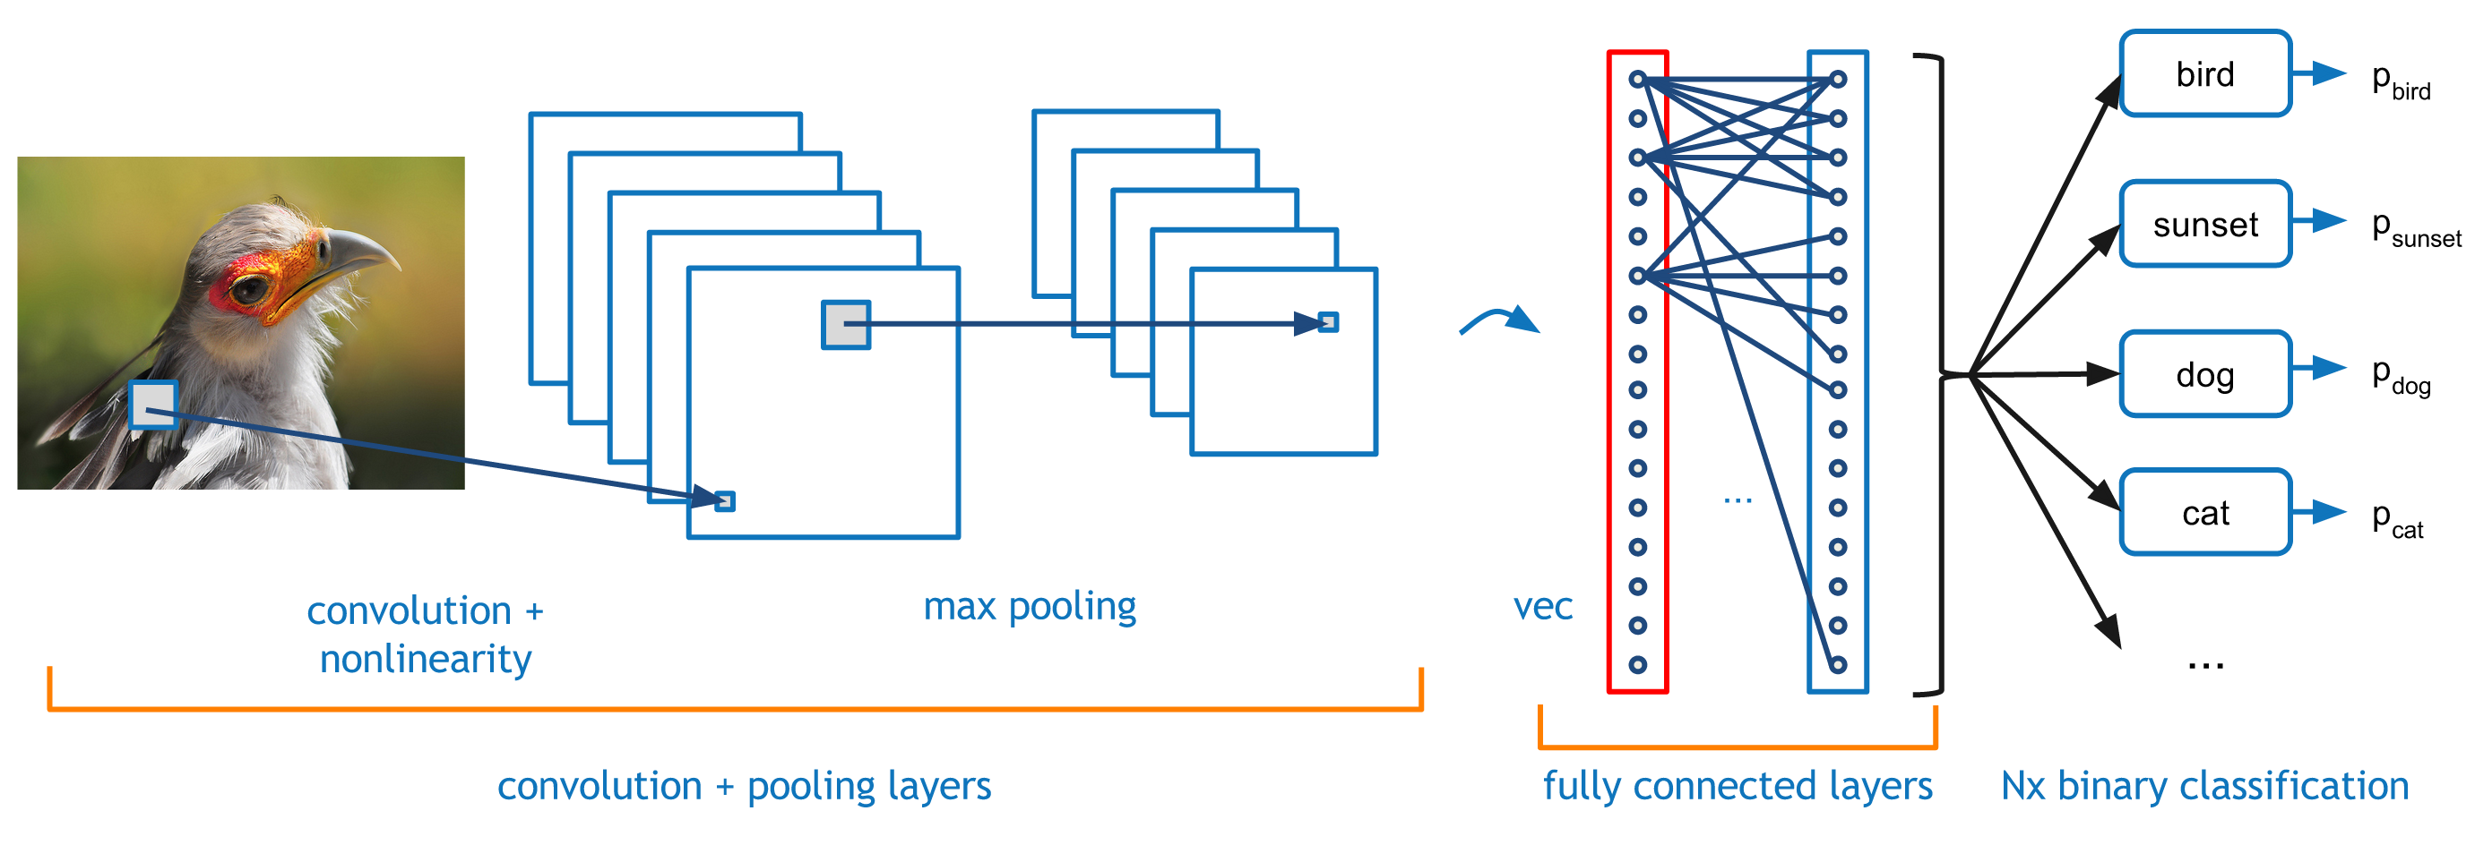
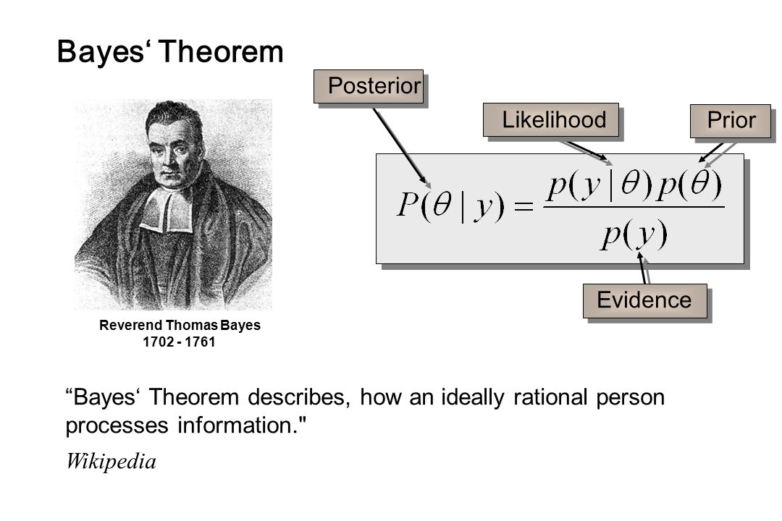
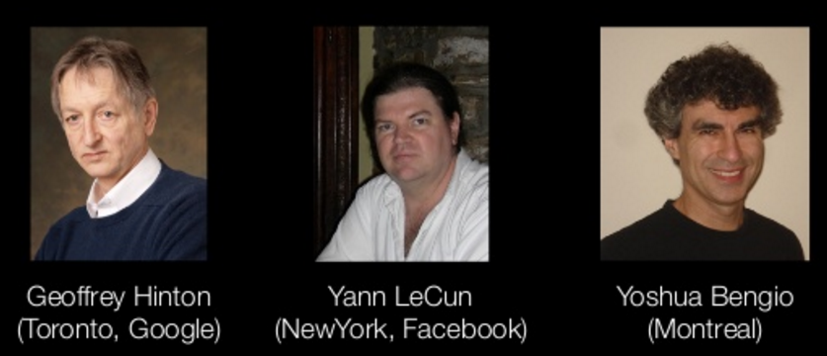
Where Have All The Successes Been?
Perceptual Tasks
Vision
NLP
Robotics
…
Statistical Approaches
Some Anomaly Detection
What has driven all of this progress?
Theoretical breakthroughs in 2006
Compute
Data
Talent pipelines
We have seen relatively little progress in the network space. Why?

Slide 14
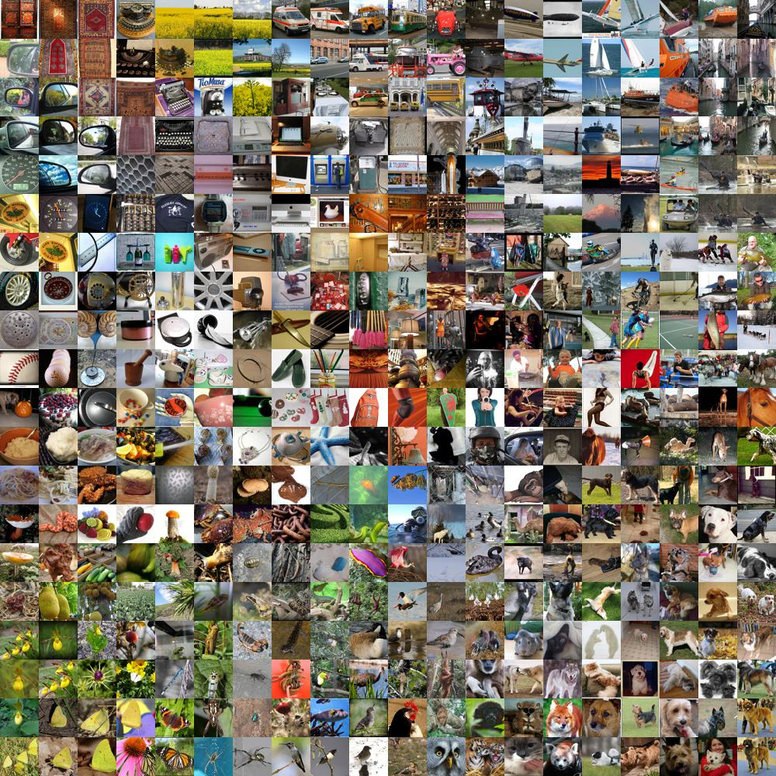
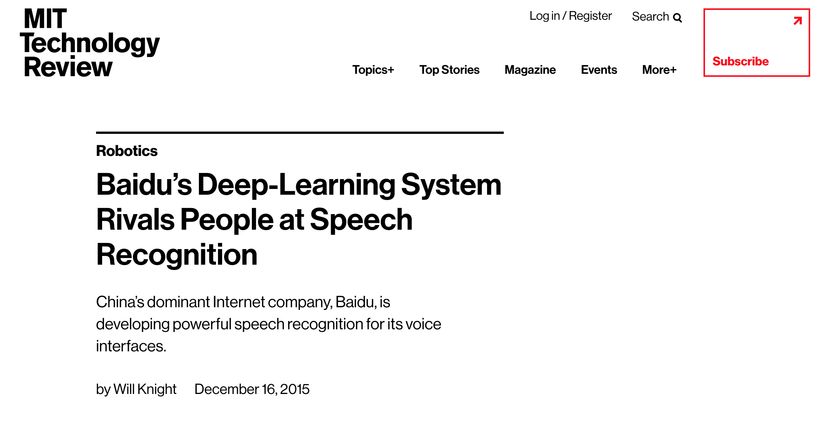
Data
Standardized data sets have been a crucial factor in the success of ML
http://yann.lecun.com/exdb/mnist/
http://image-net.org/
http://allenai.org/data.html
…
Data is the rocket fuel of Machine Learning – Andrew Ng
Allows for direct comparison of learning and inference algorithms
The result has been the steady ratcheting down of error rates on perceptual tasks to super-human levels
Object/Scene recognition
NLP/Voice recognition and generation
AlphaGo
...
We have nothing like this for networking
Many/most data sets are toy, noisy, incomplete, unnormalized, …
Many data sets are proprietary
Much data non-iid
Most of our data sources (e.g., netflow) are representations of network data that were not built for ML
→ Effective ML systems that rely on network data will require new learning algorithms and abstractions
There is no standard way to integrate network data with other data sources like CPU usage, memory, ...

Slide 15
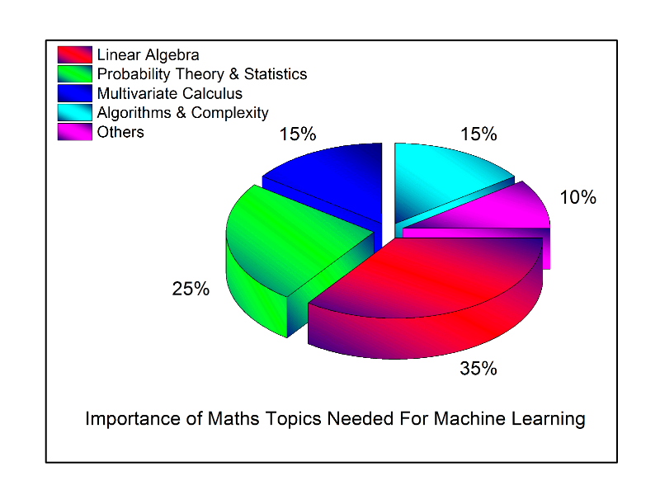
Talent Pipelines
ML is a form of Applied Mathematics
Moreover, it is a multi-disciplinary empirical science
Network engineers (us!) typically don’t have backgrounds that include the kinds of mathematical training and experience that are essential in the ML space
Effective ML requires additional skills
Ability to rapidly learn new concepts
Data modeling and evaluation
Communications
Software engineering and system design
ML algorithms and libraries
…
The result is that there is a serious skills gap
Open source frameworks are easing this problem
However, deploying ML at scale still requires intimate understanding of the mathematics
Further, most ML {under}graduates train on perceptual tasks

Slide 16
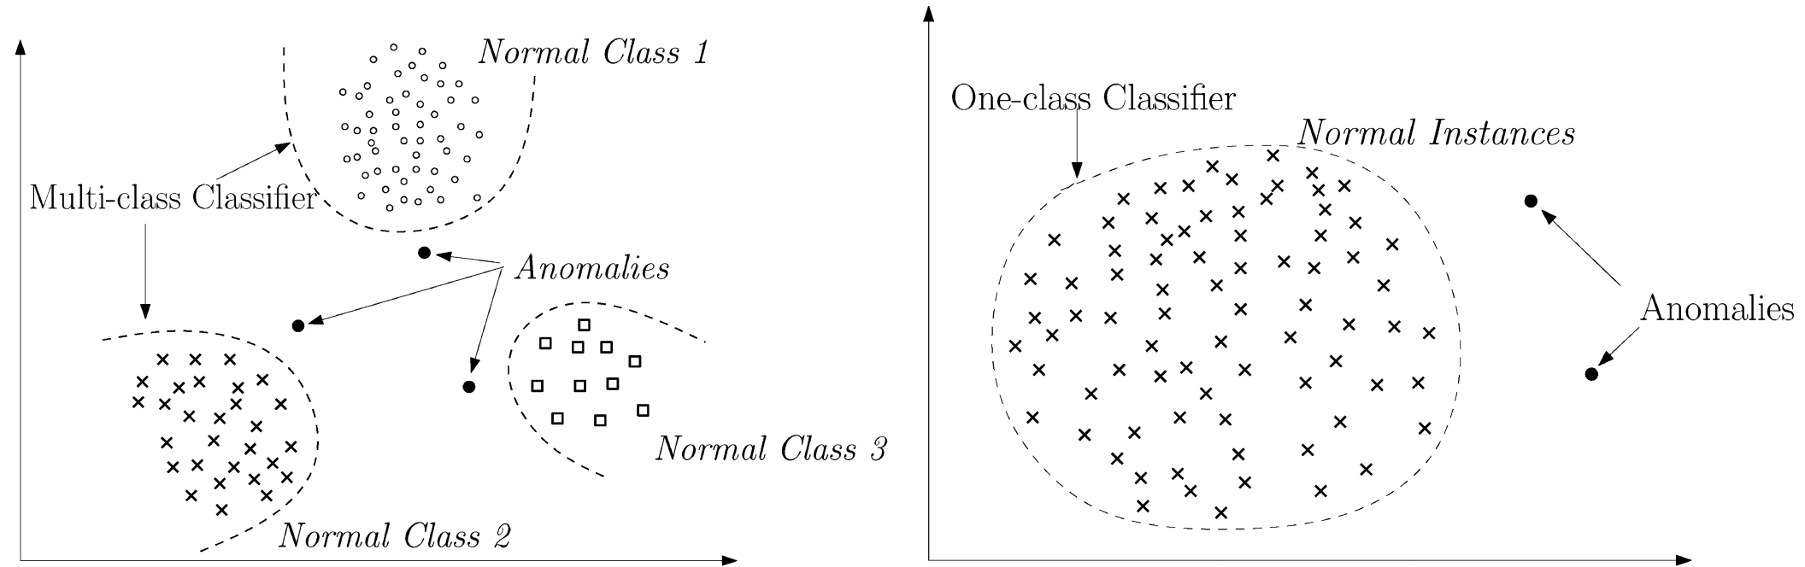
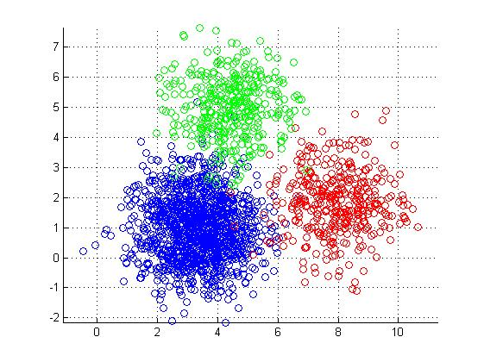
Anomaly Detection as a Classification Problem
What is going on here?
Data don’t fit an explanation model
Impossible, assuming the model is correct
Data do not conform to some normal behavior
Clustering
- K-means
- K-NN
- …
PCA
Autoencoders
….
Dimension
Reduction
We assume that the anomalous data are generated by a different
process than our baseline → stationary distribution
Original slide courtesy Armin Wasicek
Notes:
1. A = { x | s(x) > t }
2. f(A) → e ∧ min_{e}( False Positives , …)

Slide 17
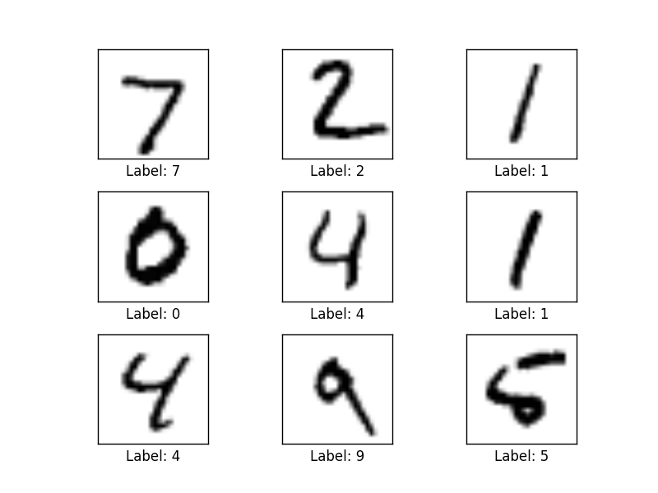
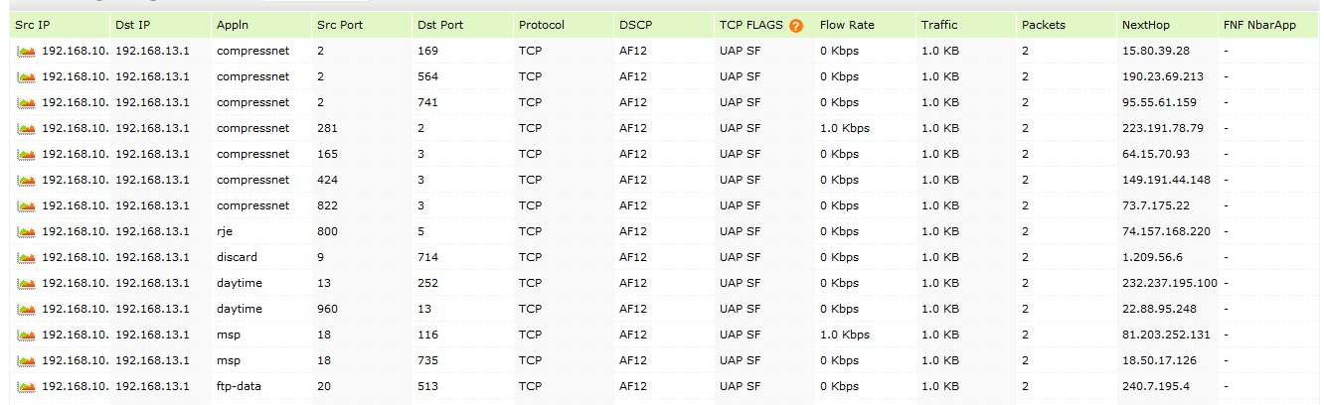
Autoencoder Example Detecting Anomalies in Handwritten Digits
MNIST: 28x28 Grayscale Handwritten Digit Dataset
Training set: 55000 images
Test set: 10000 images
Validation set: 5000 images
Features here are pixels (28x28 = 784)
I’m using MNIST here because you easily visualize what is going on. In our case, instead of the input being vectors of {0,1} we will have vectors of counters of various features s/a bandwidth, and other network and host based metrics/KPIs.
We can analyze mapping system data in the same way
Features here are
various counters
andother KPIs

Slide 18
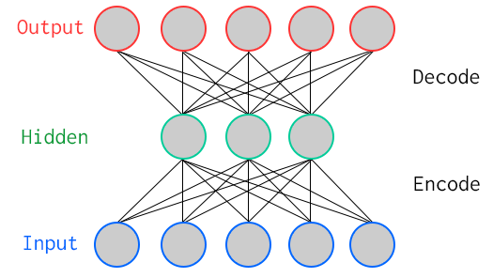
One Way To Learn To Recognize MNIST: Use An Autoencoder Special Kind of Neural Network
784
Artificial Neurons
100
Artificial Neurons
784
Key Characteristic: Hidden layer has fewer units than input/output → Compression
Goal: Minimize reconstruction (decode) error
How to define error (loss, cost)?
Binary classification: Threshold reconstruction error → normal/abnormal
Unsupervised learning

Slide 19
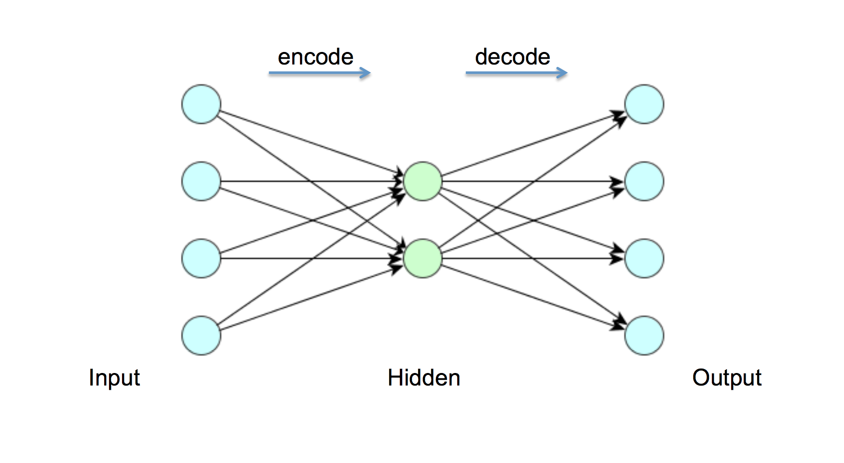
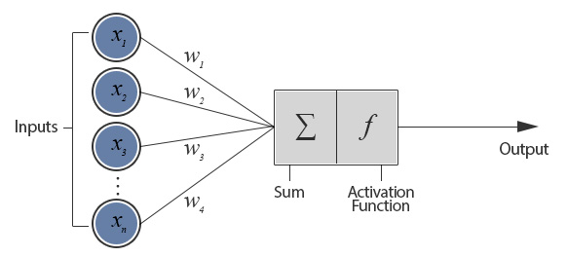
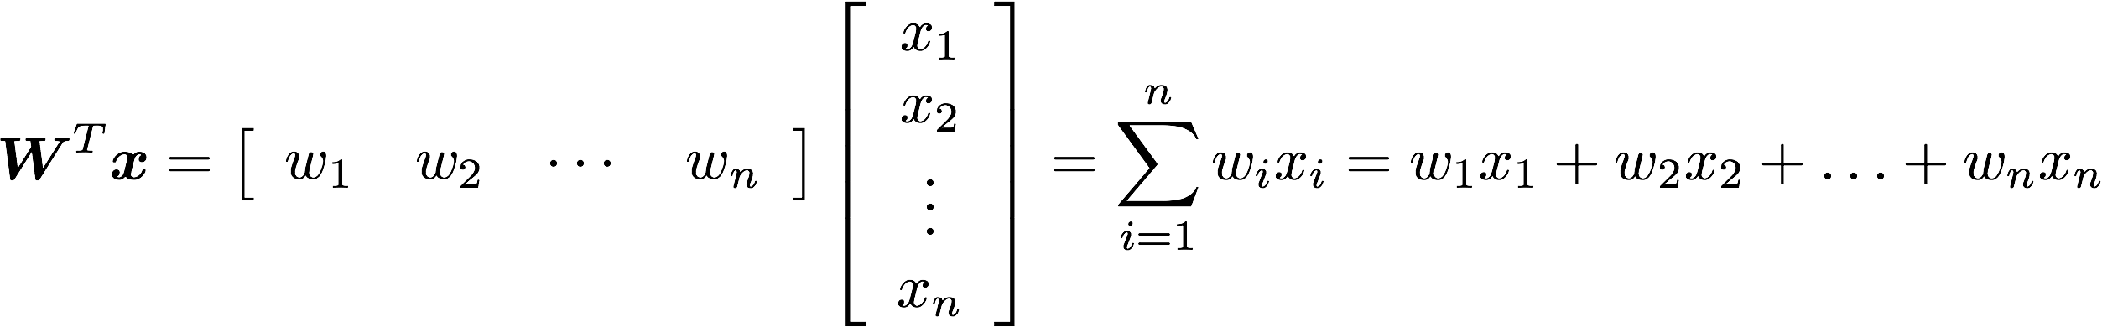
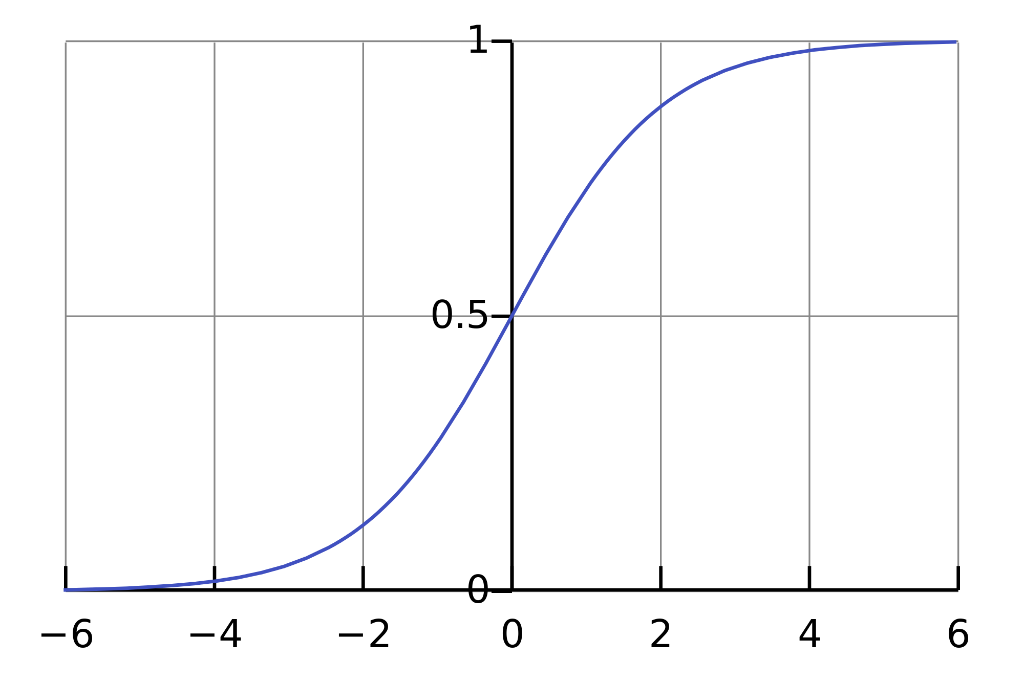
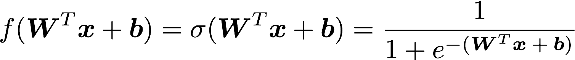
But First: What Does A Single Neuron Do?
Dot Product
784
100
784
BTW, how many parameters?
784x100 + 100x784 = 156800

Slide 20
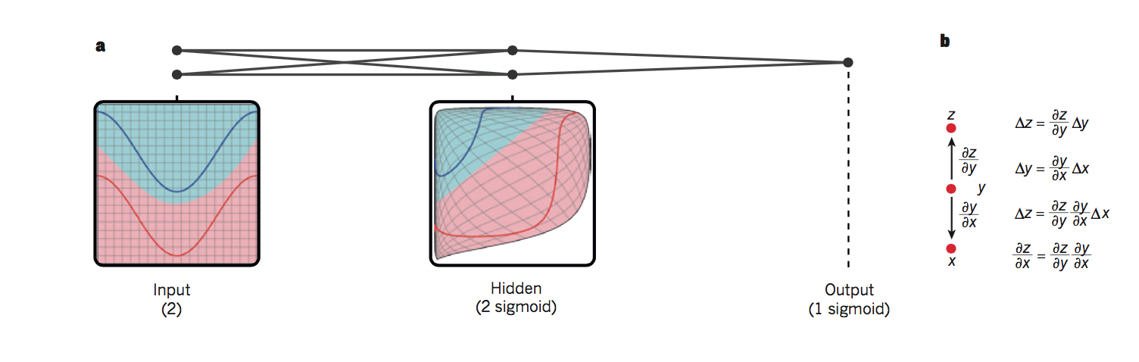
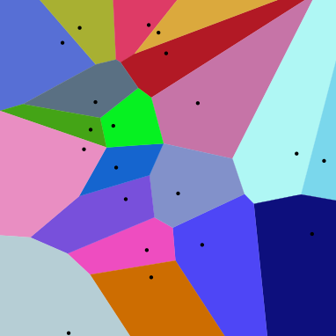
So What is Really Happening Here?
Linear Decision Boundary
Target function represented by input data is some twisted up manifold
Deep Nets disentangle the underlying explanatory factors in the data so as to make them linearly separable
Graphic courtesy Christopher Olah
Voronoi diagram under Euclidian distance
Voronoi diagram under Euclidian distance
Linear Separability in a Neural Network
Linear Separability in a Neural Network

Slide 21
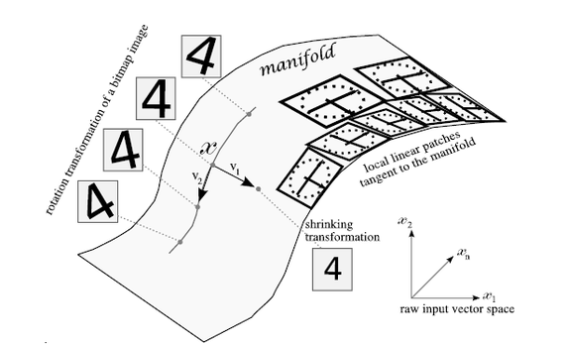
Manifolds?
X is a high dimensional vector (28² = 784)
Data concentrated around a lower dimensional manifold
Hope to find representation R of that manifold
Graphic courtesy http://www.deeplearningbook.org

Slide 22
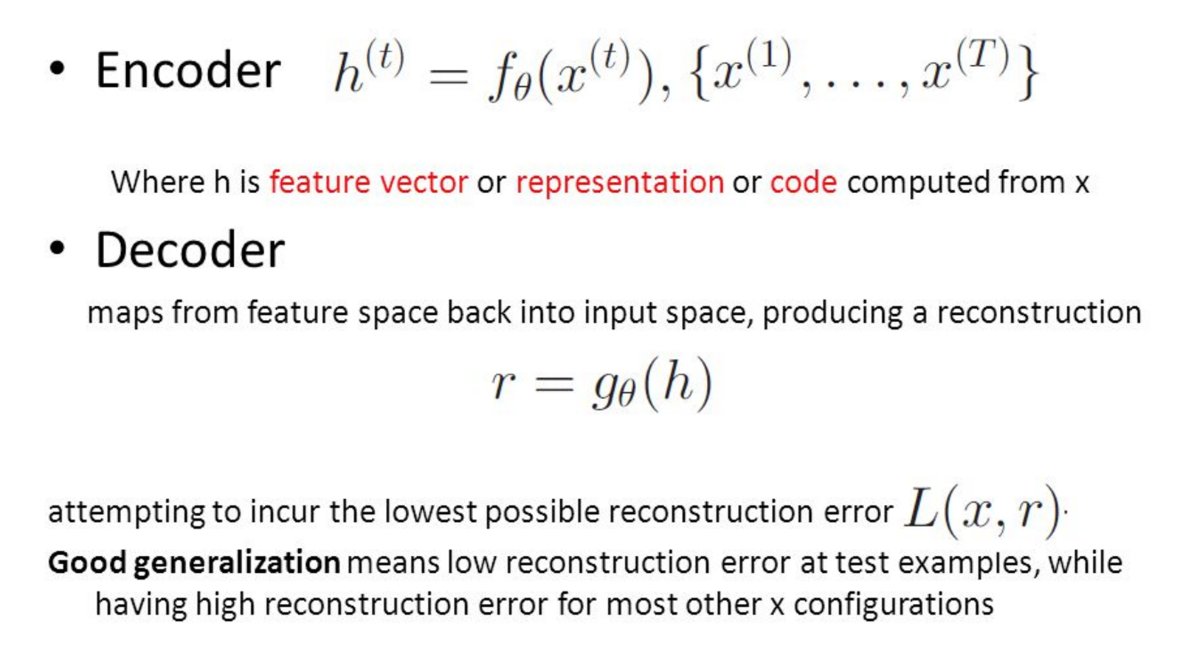
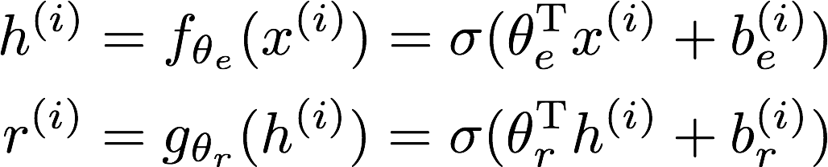
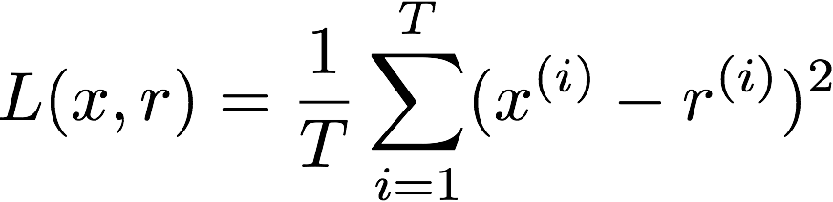
So OK, All Cool, But How Does The Autoencoder Actually Work?

Slide 23
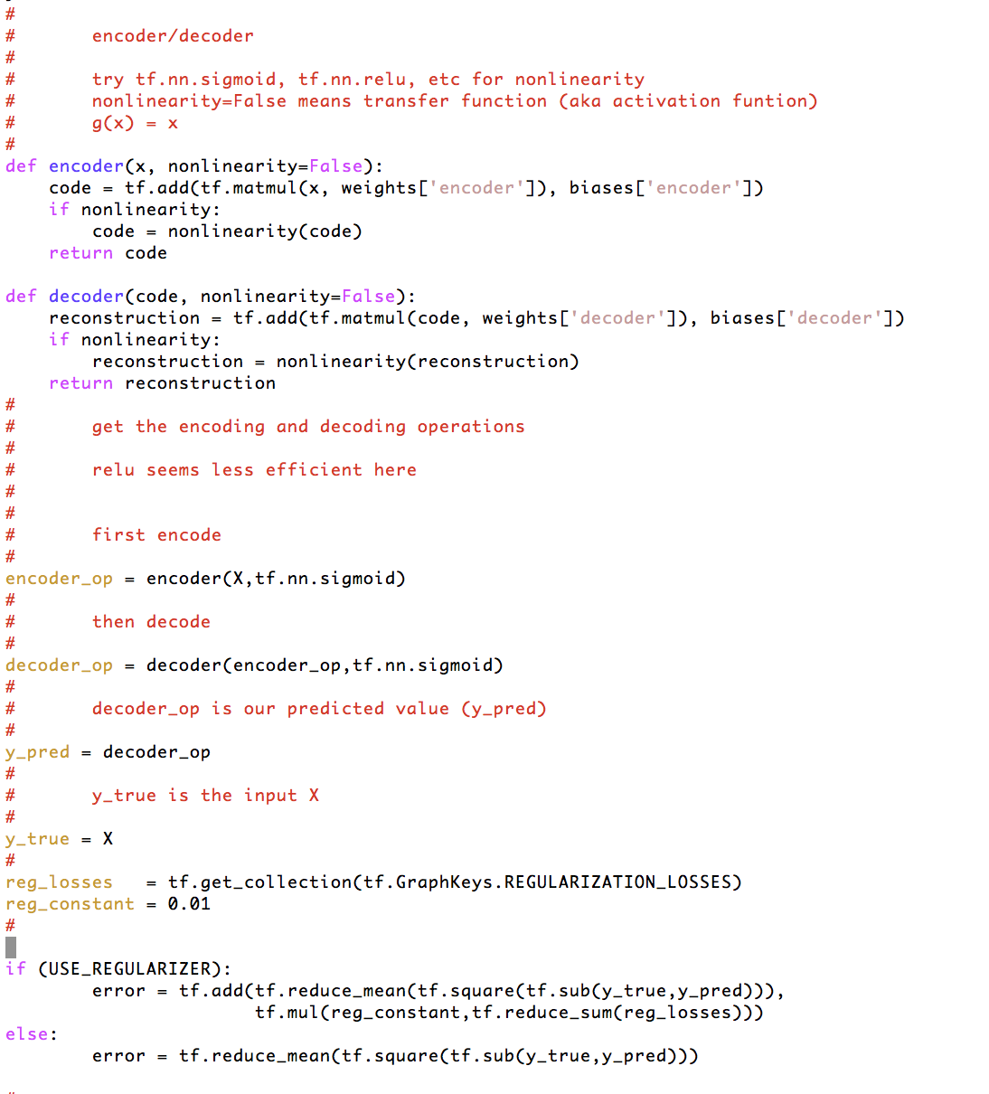

How Hard To Code This Up In Tensorflow?
https://github.com/davidmeyer/ml/blob/master/tensorflow/autoencoder.{py,ipynb}

Slide 24
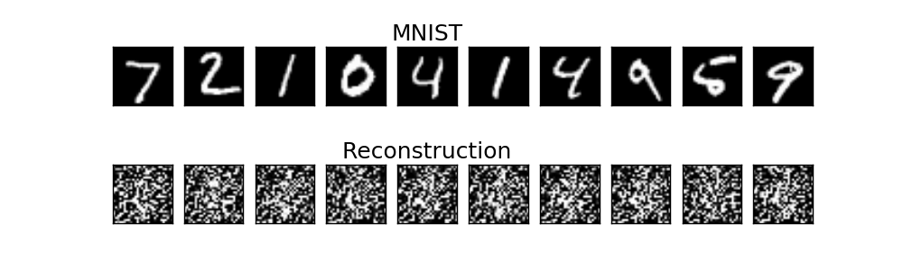
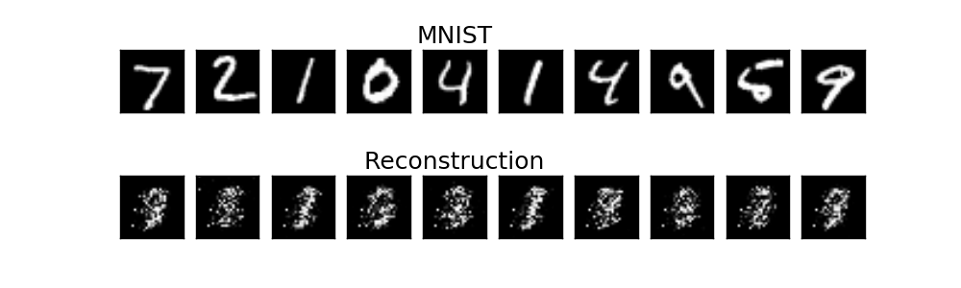
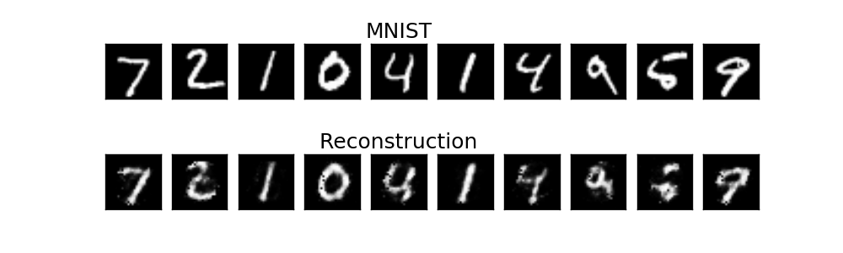
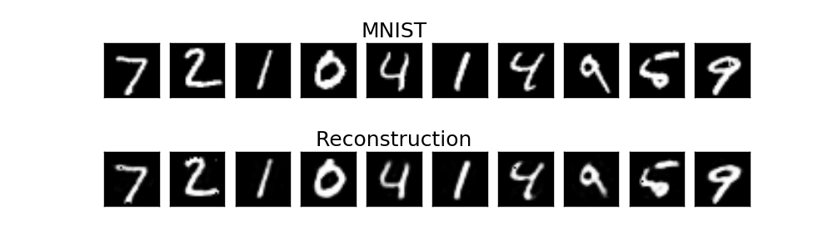
Autoencoder Output
1 example
10 examples
100 examples
1000 examples
After training, the AE gets low reconstruction error on digits from MNIST and high reconstruction error on everything else: It has learned to recognize MNIST

Slide 25
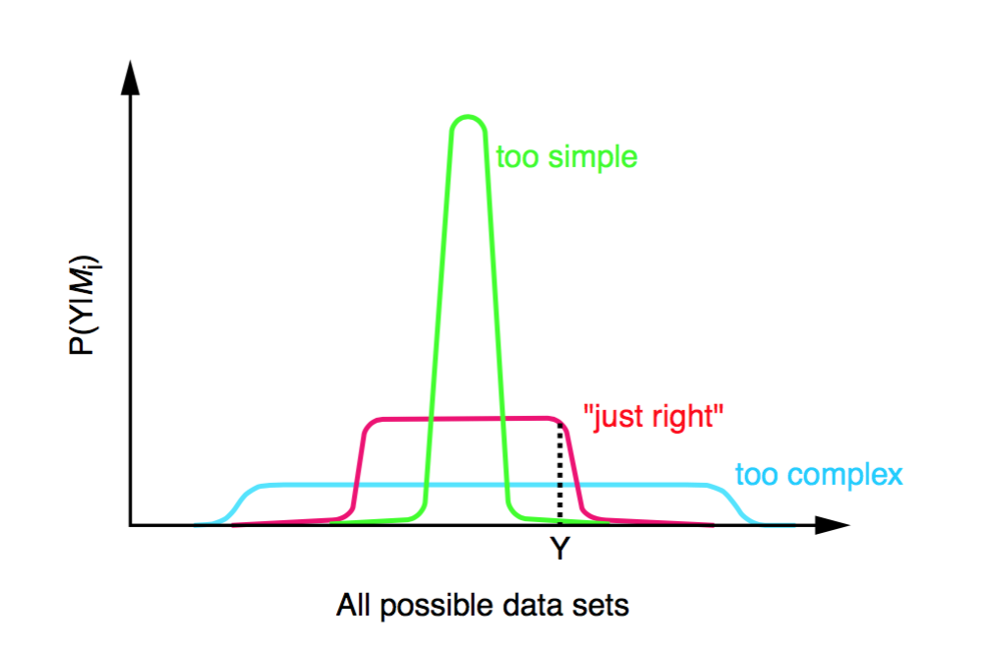
How Much Of This Has Been Applied To Networking?
Not too much. Many reasons:
Still early days
Diverse types of network data
Flows, logs, various KPIs, … with no obvious/consistent way to combine
Incomplete data sets, non-iid data
Network data not designed for ML
Different models for different data types
Still active area of investigation
Occam’s Razor
Is there a useful “Theory of Network”?
Consider the problem of object recognition/conv nets
Transfer learning
Markov Chains?
Community challenges: Skill sets, proprietary data sets and use-cases, …
Concern about the probabilistic nature of ML

Slide 26
Agenda
What Is Machine Learning?
What Can We Do Today, And What Are The Challenges?
What’s On the Horizon?
Technical explanations/code
https://github.com/davidmeyer/ml
http://www.1-4-5.net/~dmm/ml

Slide 27
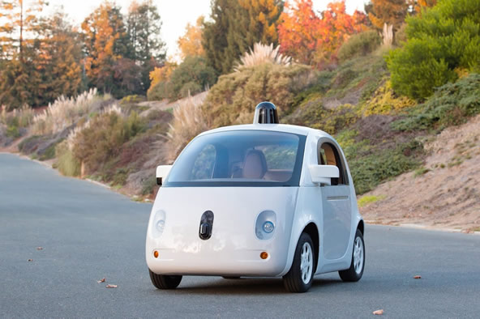
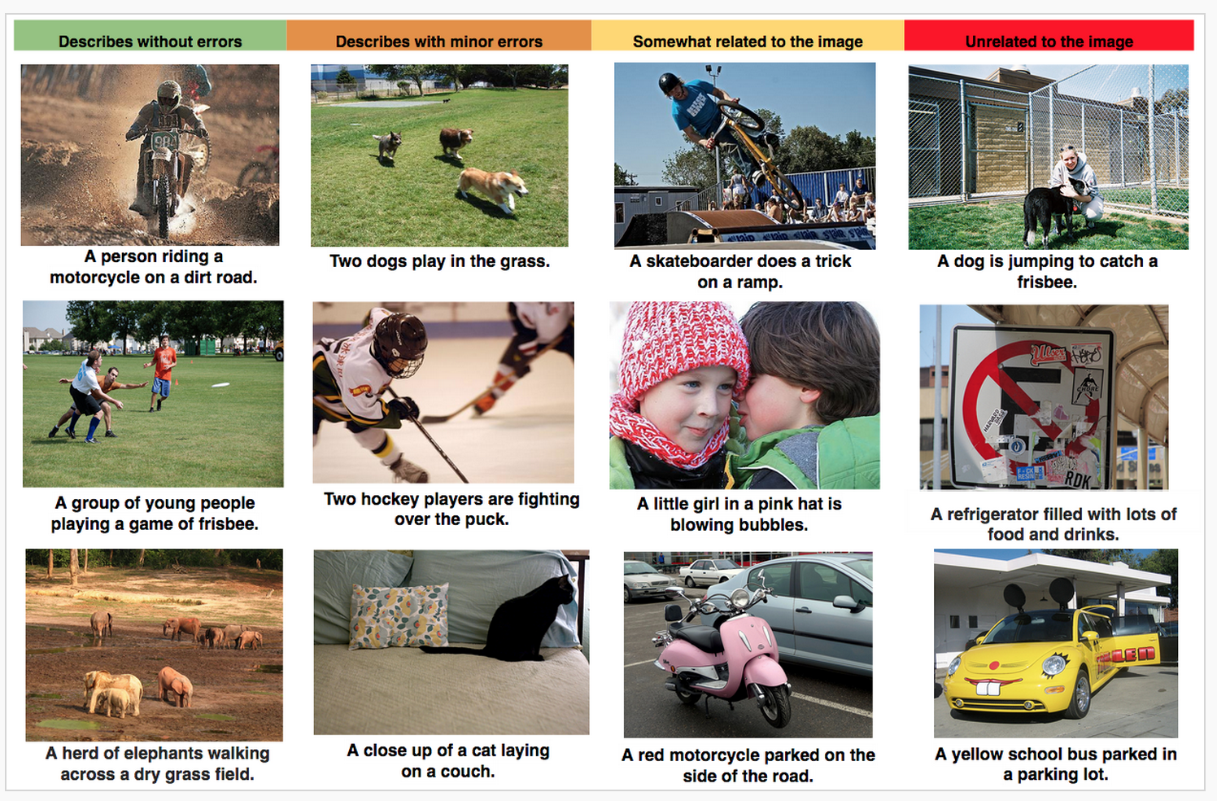

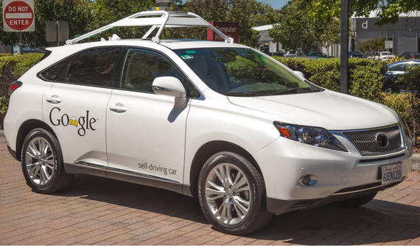
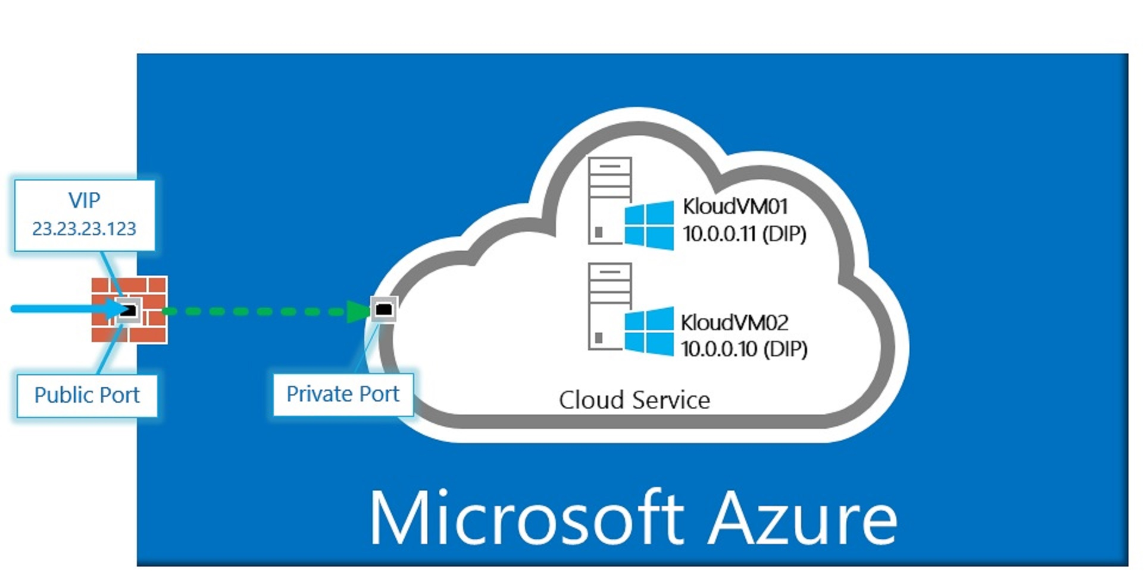
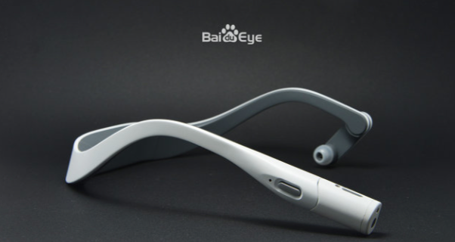

Well, We’ve Seen All of This

Slide 28
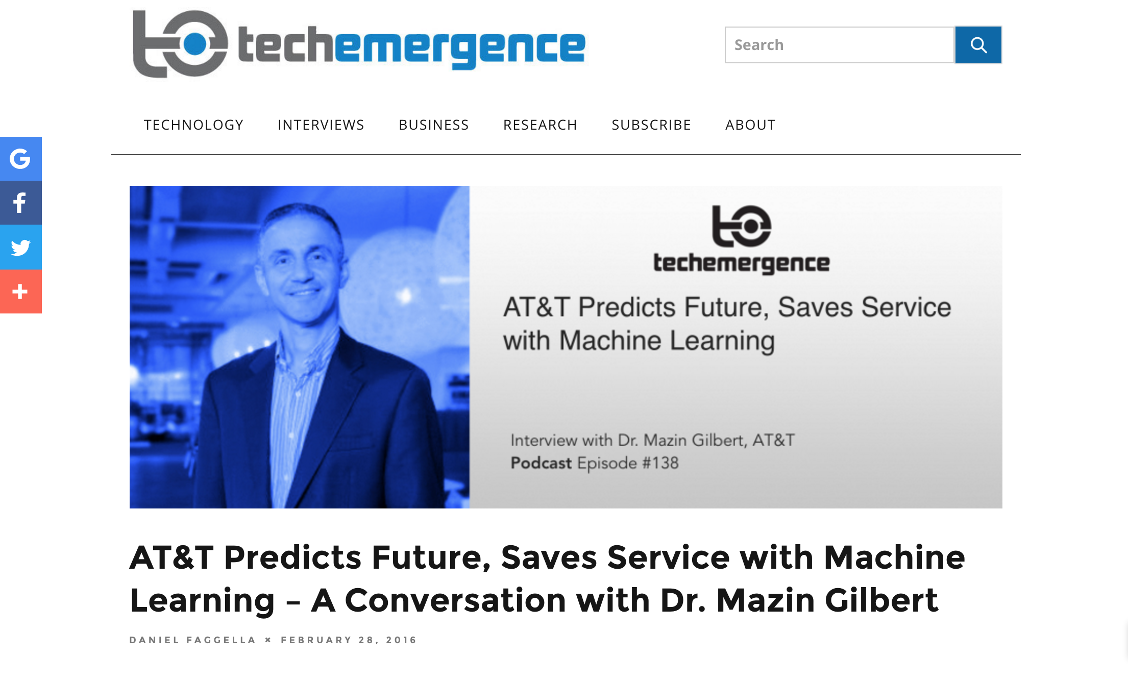
But Now…
Machine learning is revolutionizing the world as we know it, both in and out of the
digital realms, and is predicted to expand to a $2 trillion market by 2025.

Slide 29
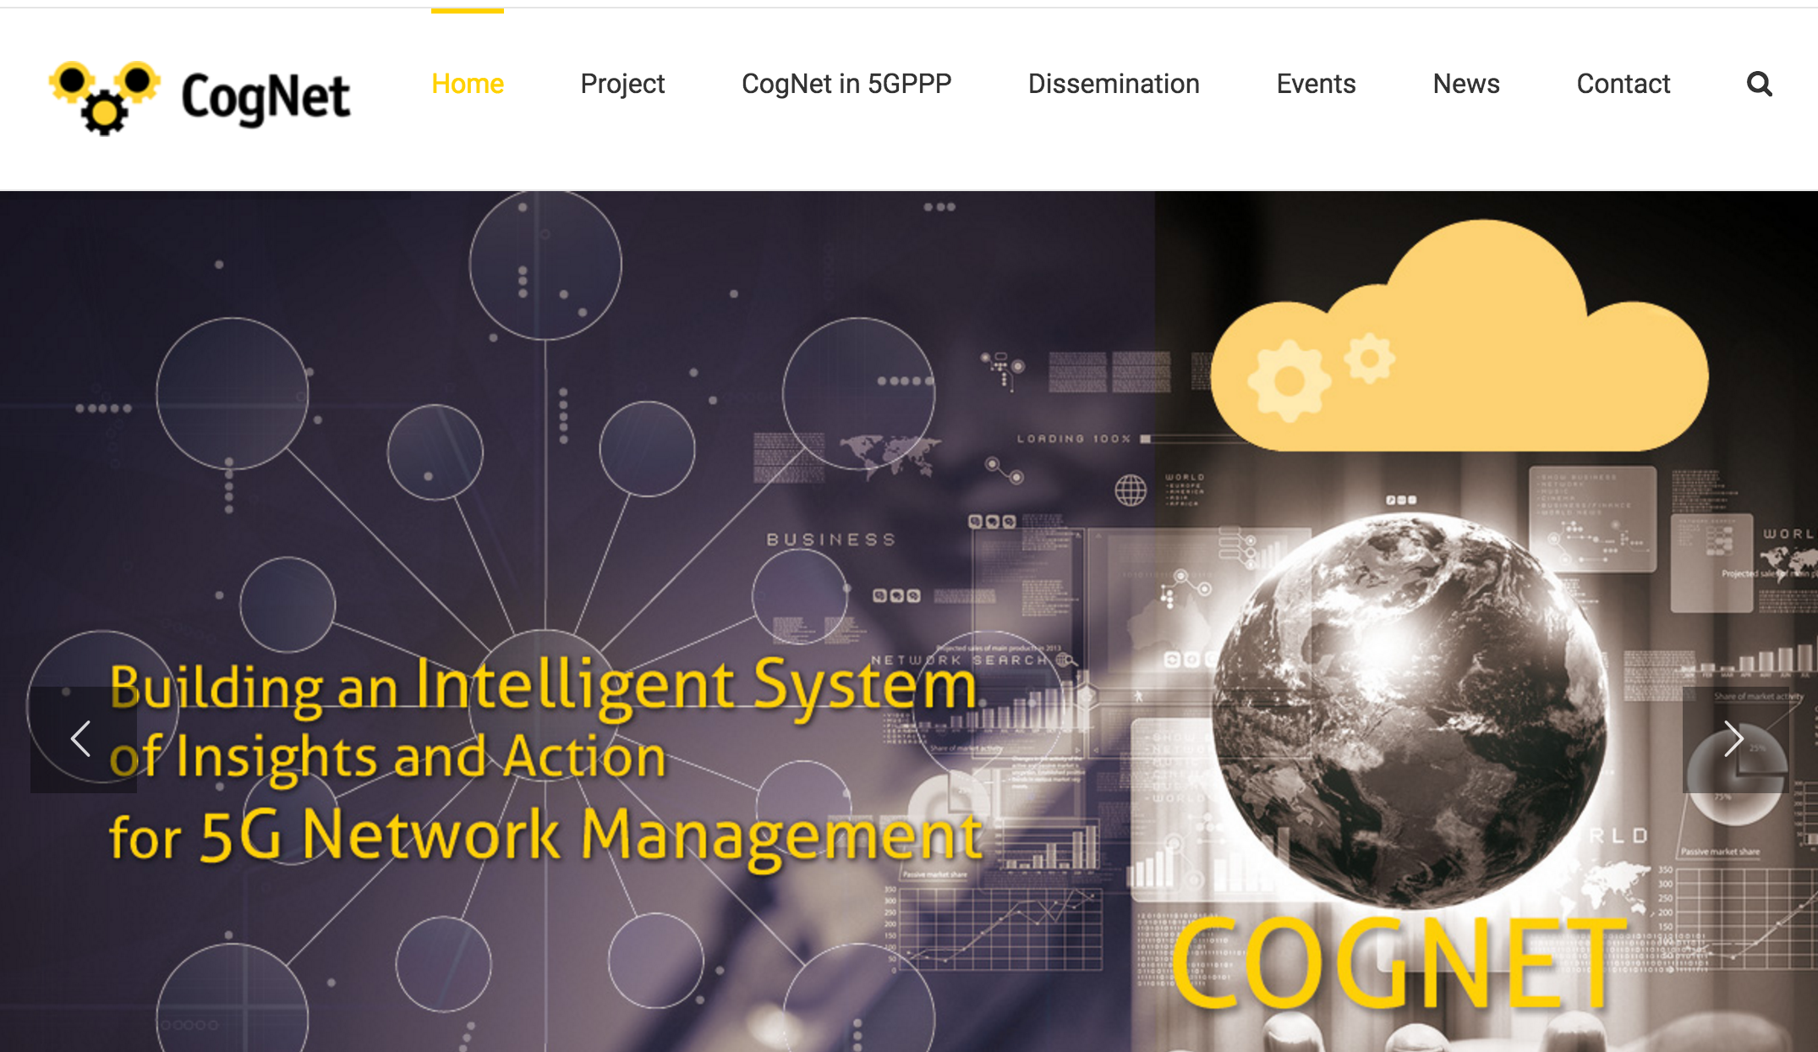
5G Networks

Slide 30
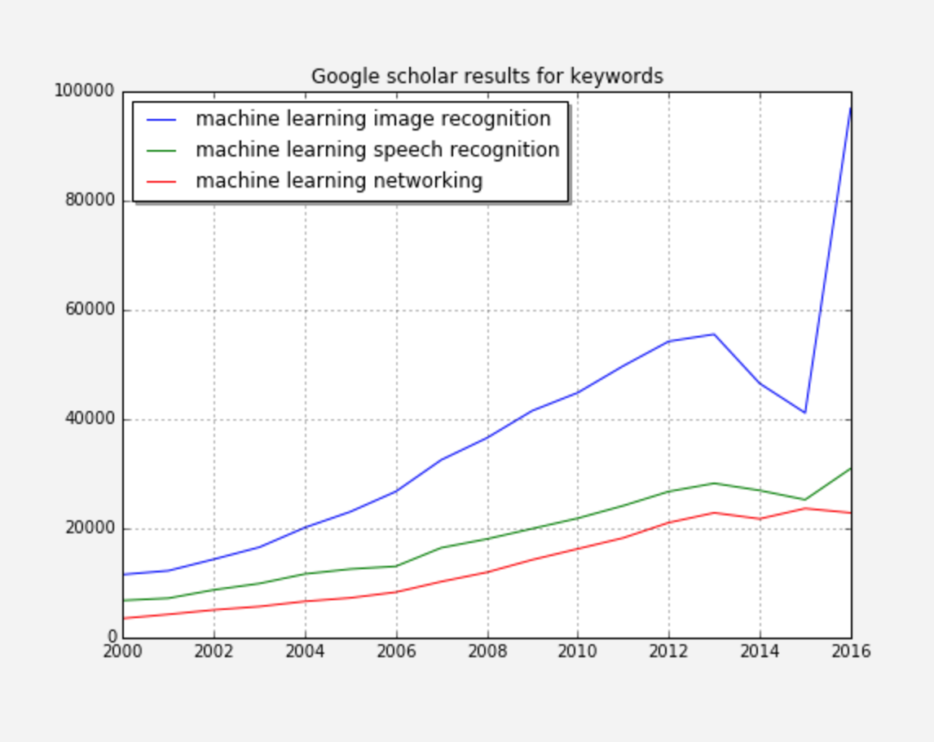
However….

Slide 31
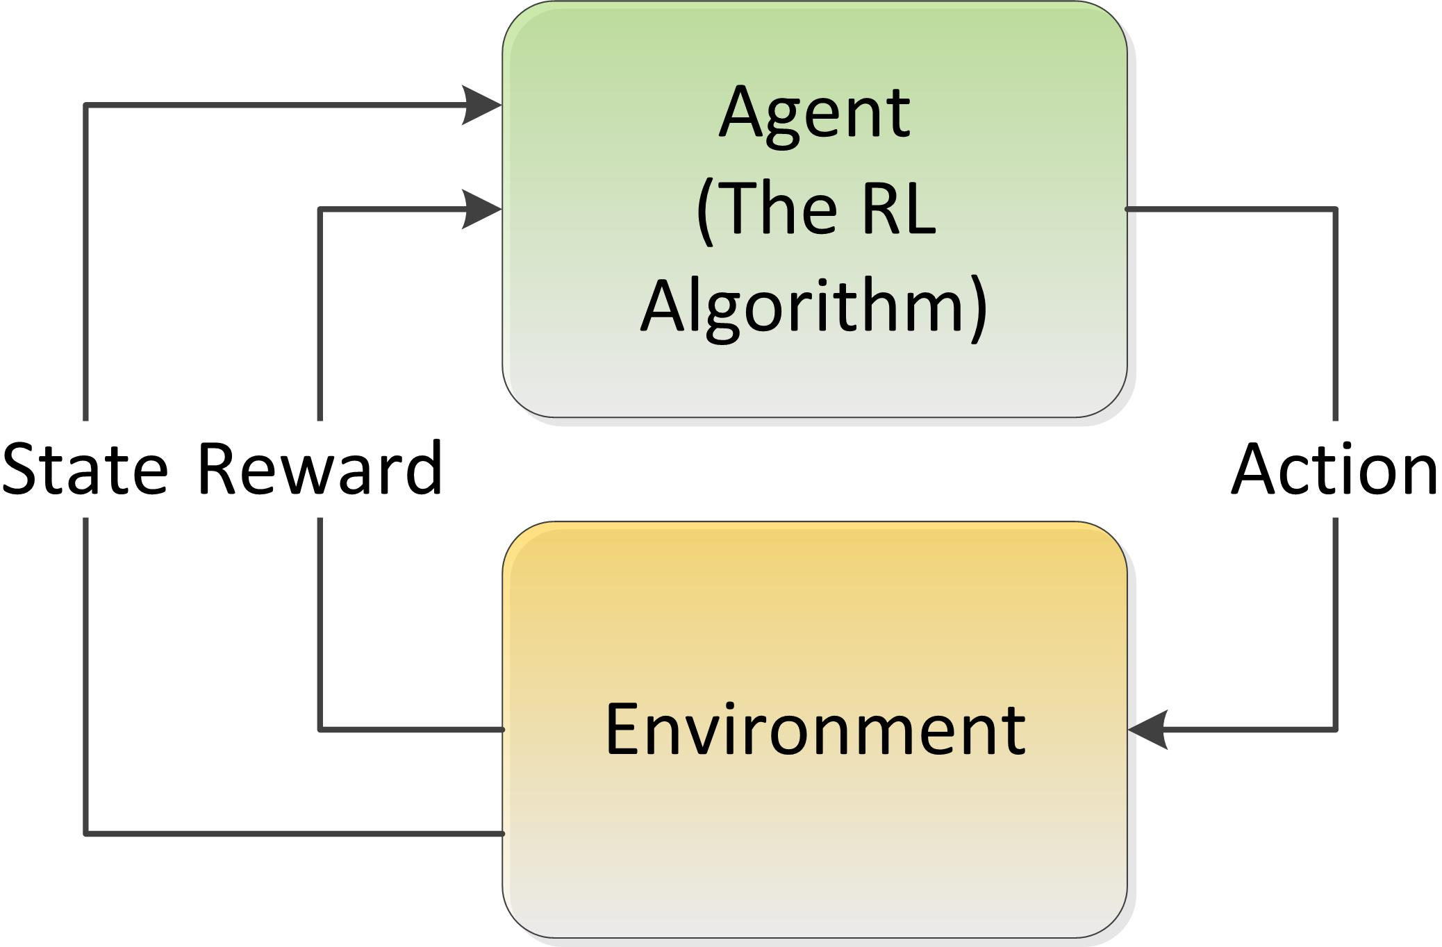
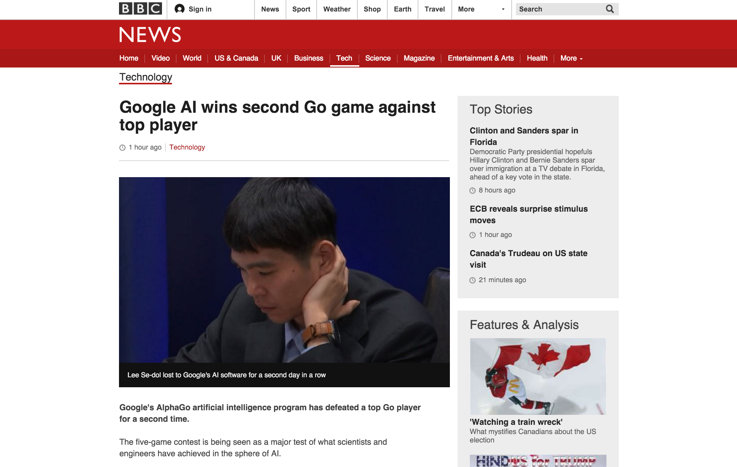
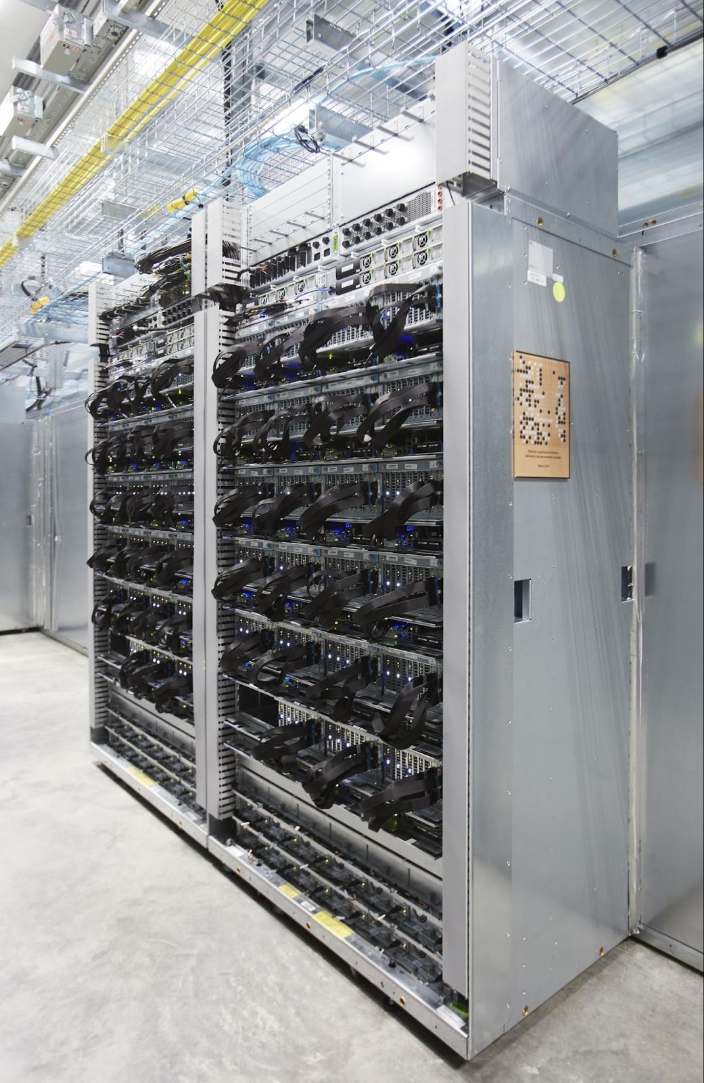
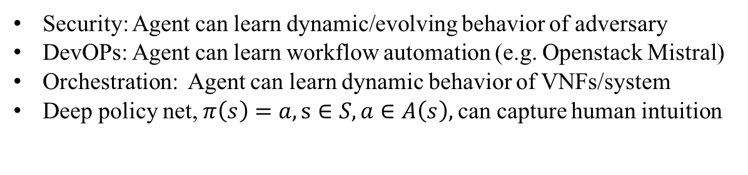
We Want To Learn Control Reinforcement Learning Meets Monte Carlo Tree Search and Deep Learning
Hard coded control logic (not learned)
Security: Agent can learn dynamic/evolving behavior of adversary
DevOPs: Agent can learn workflow automation (e.g. Openstack Mistral)
Orchestration: Agent can learn dynamic behavior of VNFs/system
Deep policy net, $π\left(s\right)=a, s∈S, a∈A\left(s\right),$can capture human intuition
http://www.nature.com/nature/journal/v529/n7587/full/nature16961.html

Slide 32
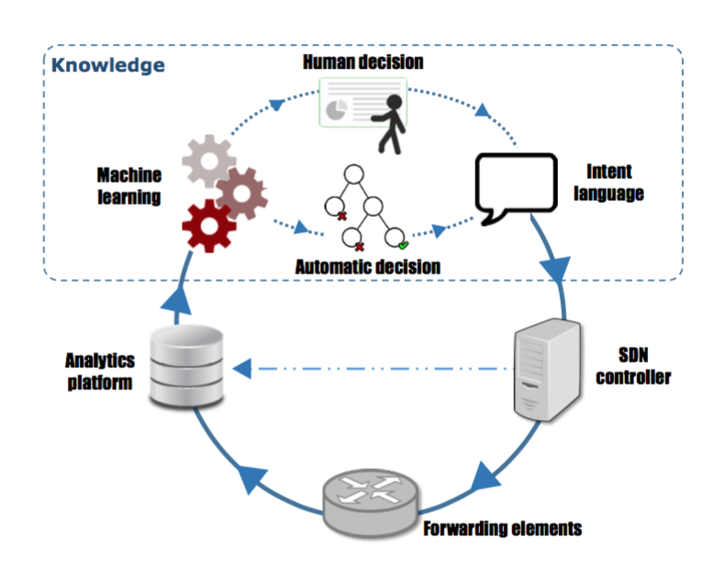
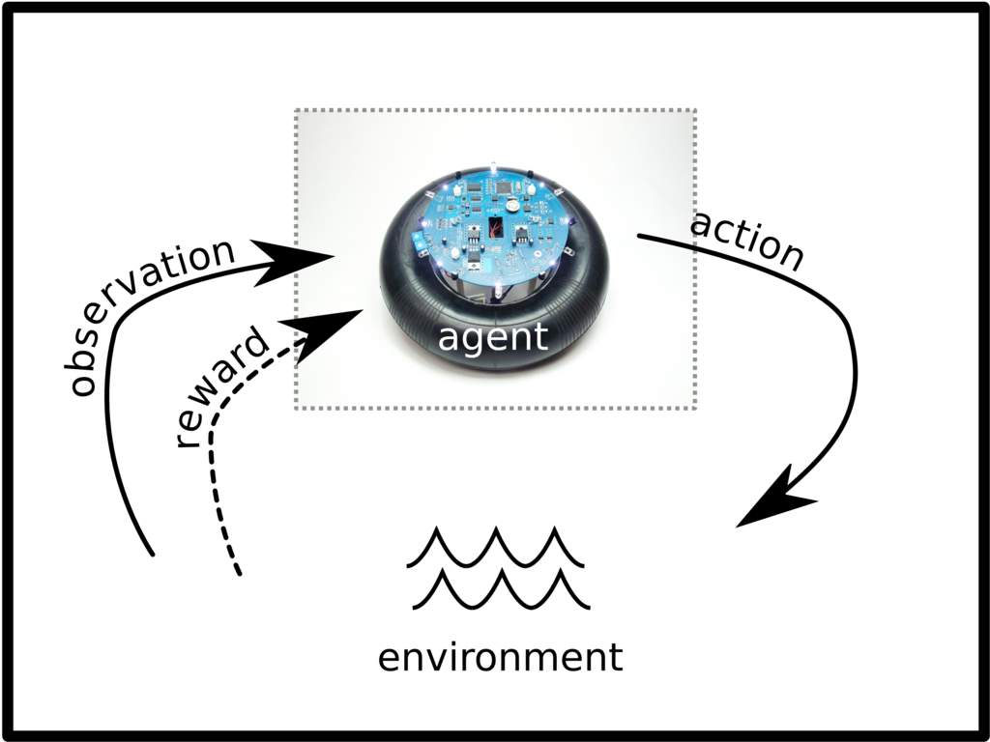
Static vs. Reinforcement Learning Architectures
Today’s Static ML Architectures
ML doesn’t have “agency”
Hard-coded or open loop control
Doesn’t learn control
Assumes stationary DGD
Largely off-line
Reinforcement Learning Architecture
Agent architecture
Agent learns control/action selection
Adapts to evolving environment
Non-stationary distributions
Network gamification

Slide 33
Summary
Lots of Network Data
Standardized and labeled datasets still scarce
However, most network data sources (e.g., netflow) not designed for ML
Lots of open source ML frameworks, Cloud APIs, Examples, …
Tensorflow (tensorflow.org)
Torch (torch.ch)
Scikit-learn (scikit-learn.org)
Many others
Skills gap persists and it still requires skill/experience to
Build DNN architectures/models
Find ”good” settings for hyper-parameters
Prevent overfitting
…
All of this said, you will be seeing ML in all facets of networking
And everything else for that matter

Slide 34
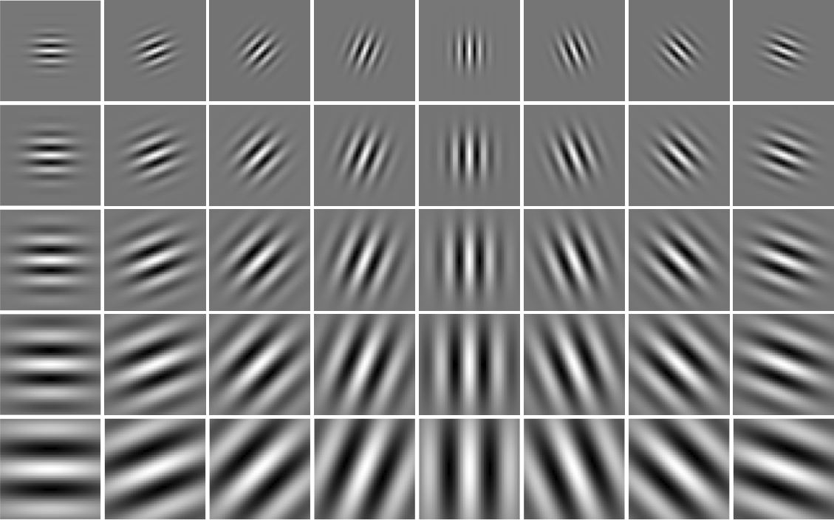
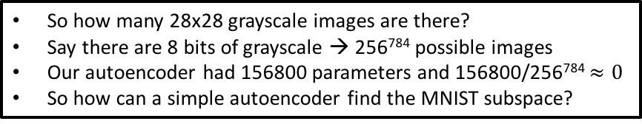
Finally…Many Beautiful Mysteries Remain
Back-propagation
Gradient-based optimization with gradients computed by back-prop
Why is such a simple algorithm so powerful?
Optimization an active area of research
Many new techniques , e.g., Layer Normalization
https://arxiv.org/pdf/1607.06450v1.pdf
Neural Nets
What are the units (artificial neurons) actually doing?
https://arxiv.org/pdf/1509.06321.pdf
Adversarial Images/Generative Adversarial Nets (GANs)
https://arxiv.org/abs/1412.6572
Why does deep and cheap learning work so well?
Physics perspective
http://arxiv.org/pdf/1608.08225v1.pdf
And many more
So how many 28x28 grayscale images are there?
Say there are 8 bits of grayscale → 256⁷⁸⁴ possible images
Our autoencoder had 156800 parameters and 156800/256⁷⁸⁴ $≈0$
So how can a simple autoencoder find the MNIST subspace?

Slide 35
Agenda
What Is Machine Learning?
What Can We Do Today, And What Are The Challenges?
What’s On the Horizon?
Technical explanations/code
https://github.com/davidmeyer/ml
http://www.1-4-5.net/~dmm/ml

Slide 36
Q&A
Thank you
(have more questions/comments? dmm@1-4-5.net)

